Slide 1
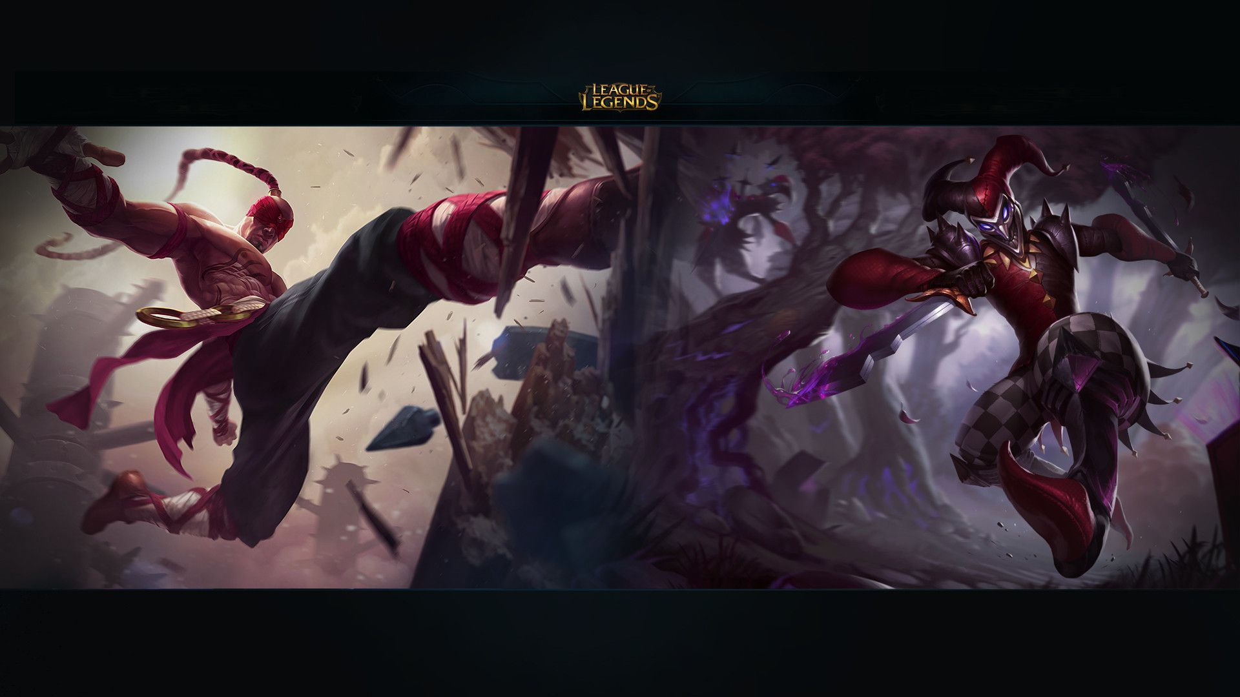

Games
Item Recommendation
By Muhammad Alaa – Jan 10, 2022

Slide 2
Data Mining for item recommendation in MOBA
MOBA
Recommendation
Items
Data Mining

Slide 3
Recommendation System
Character recommendation
People reached a lot of achievement in it.
Item recommendation
Still an open issue for researches
But People reached a good point in it

Slide 4
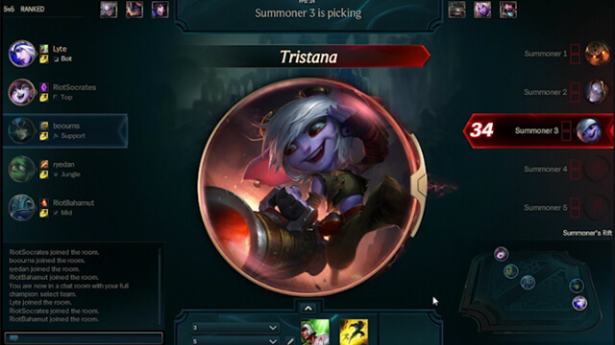
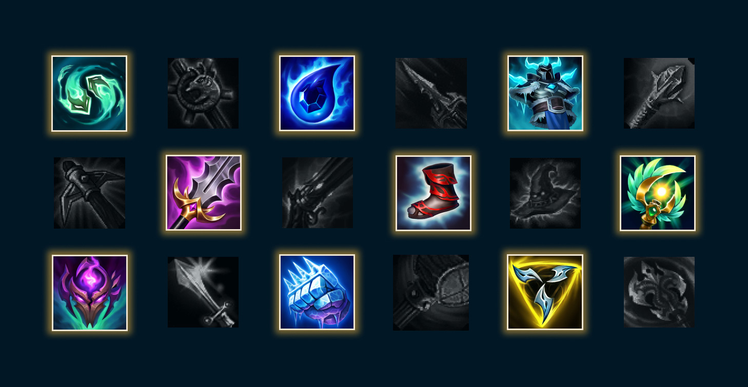
Game Explanation

Slide 5
Data Mining
Data Set
Recommend
Preprocessing and Filtration
Recommend based on context

Slide 6
Context
Certain state
Better state
Win Game
Buy Item
Buy Item
Buy item
Buy Item
Buy Item
Better state
Better state

Slide 7

Benefits
New Players
Pro Players
Attract new player by the recommendation so they get best experience
Suggest new strategies for complex scenarios

Slide 8
THANK YOU

